Slide 1



Creative Commons Licences for e-Dictionaries
Jessica Coates
Project Manager
Creative Commons Clinic
AUSTRALIA
part of the Creative Commons international initiative

Slide 2

Introduction to CC
Founded in 2001 by US academics, including Prof. Lawrence Lessig
Concerned that default copyright laws were restricting creativity in the digital environment
Aims to make creative material more freely available through open access licences
AUSTRALIA
part of the Creative Commons international initiative
Notes:
Non-profit
Founded in 2001
These academics became concerned that the default copyright laws that applied in most countries were restricting creativity in the digital environment by preventing people from being able to access, remix and distribute copyright material online
For instances – most people know that it’s currently illegal under Australian law to record a television show to watch later – but did you also know that, in the absence of any licence, it’s also arguably illegal to print off a webpage for personal use, or to use a song in the background of a home video, or a student film
Even those people who want to make their material more freely available can’t do so without hiring lawyers
Taking inspiration from the open source movement, they decided to develop a set of licences that creators could use to make their material more freely available without giving up their copyright
They wanted to replace the standard “all rights reserved” model with a new, more flexible, “some rights reserved”

Slide 3
CC as Tool
CC licences are designed to:
facilitate sharing;
be flexible;
be easy to use and understand; and
apply in the same way anywhere in the world.
AUSTRALIA
part of the Creative Commons international initiative
Notes:
In writing the licences, the main goal was to ensure that the licences are:
Voluntary – contrary to some claims, CC isn’t anti-copyright. It just aims to provide options for those copyright owners who do want to make their material more freely available
Flexible – unlike other parts of the open access movement, CC licences are specifically designed to provide a range of options for licensors, so that they can choose exactly how they want their material to be used
Easy to understand – the academics designing the licences felt that one of the biggest problems with default copyright law is that its so hard for both copyright owners and users to understand. So the licences are specifically designed to be as simple as possible.
And, of course, freely available for everyone to use

Slide 4
Introduction to CC
CC licences are not:
Anti-copyright – just another rights management tool for creators
Anti-commercial – can charge for first use, commercial uses, “gold” service, or embed advertising
Right for every situation – look carefully at what you want
AUSTRALIA
part of the Creative Commons international initiative
Notes:
Non-profit
Founded in 2001
These academics became concerned that the default copyright laws that applied in most countries were restricting creativity in the digital environment by preventing people from being able to access, remix and distribute copyright material online
For instances – most people know that it’s currently illegal under Australian law to record a television show to watch later – but did you also know that, in the absence of any licence, it’s also arguably illegal to print off a webpage for personal use, or to use a song in the background of a home video, or a student film
Even those people who want to make their material more freely available can’t do so without hiring lawyers
Taking inspiration from the open source movement, they decided to develop a set of licences that creators could use to make their material more freely available without giving up their copyright
They wanted to replace the standard “all rights reserved” model with a new, more flexible, “some rights reserved”

Slide 5




Licences
4 licence elements:
        Attribution – attribute the author
        Noncommercial – private use only
        No Derivative Works – no remixing
        ShareAlike – remix only if you let others remix
AUSTRALIA
part of the Creative Commons international initiative
Notes:
The first CC licences were released in 2002
The central to each of the CC licences are the four licence elements – Attribution, noncommercial, no derivative and sharealike
These represent restrictions that copyright owners may want to put on how people can use their material.
As you can see, each of the elements has a symbol that can be used to ‘represent’ each of these elements
this makes the licences easier understand – in theory, once a person is familiar with the CC licences, they should be able to recognise what uses are allowed simply by looking at the symbols

Slide 6
Licences
creators mix and match elements to make licence
  eg Attribution-Noncommercial-ShareAlike
lets others remix, tweak, and build upon the work, as long as:
  they credit the author;
  it is for non-commercial purposes; and
  they license their new creations under the same licence
AUSTRALIA
part of the Creative Commons international initiative
Notes:
Users can mix and match these elements to set the conditions of use for their material
So, for example, an author may be happy to allow private uses of their work, but may want to limit how it can be used commercially.
They may also want people to remix their work, but only so long as that person attributes them and makes the new work available for others to remix
So they can choose the Attribution-noncommercial-sharealike licence

Slide 7
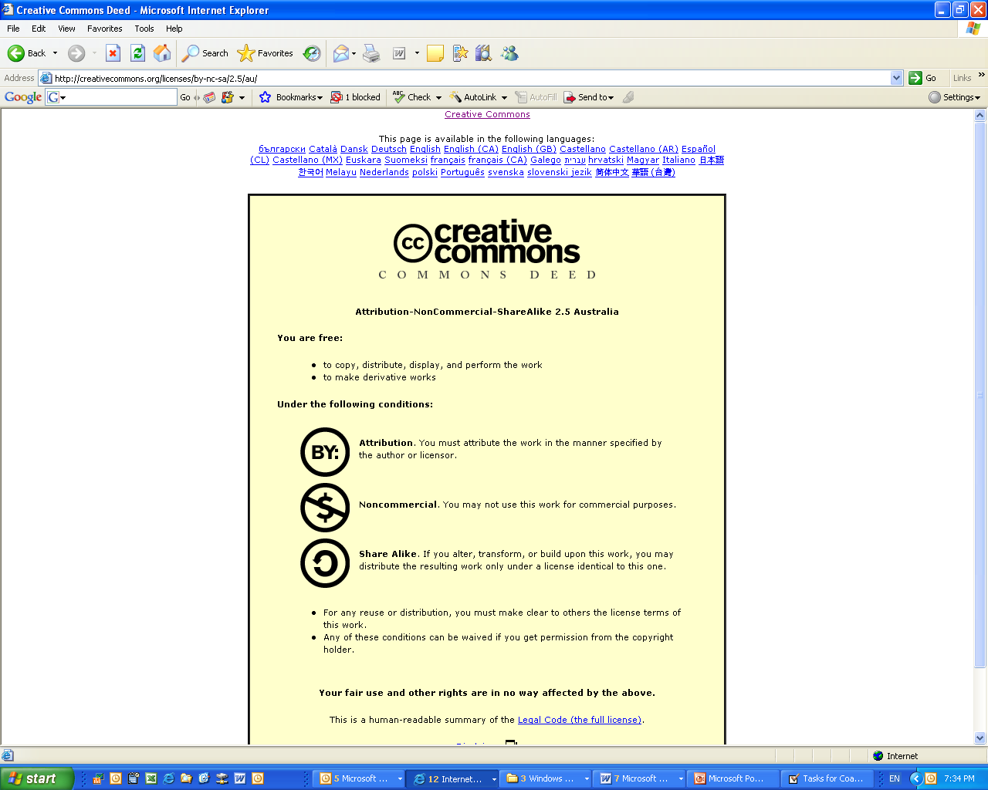
Licences
AUSTRALIA
part of the Creative Commons international initiative
Notes:
. . .to the licence deed, which sets out the licence in plain english terms
You can see the licence element symbols here
By clicking on this link here, you can access . . .

Slide 8
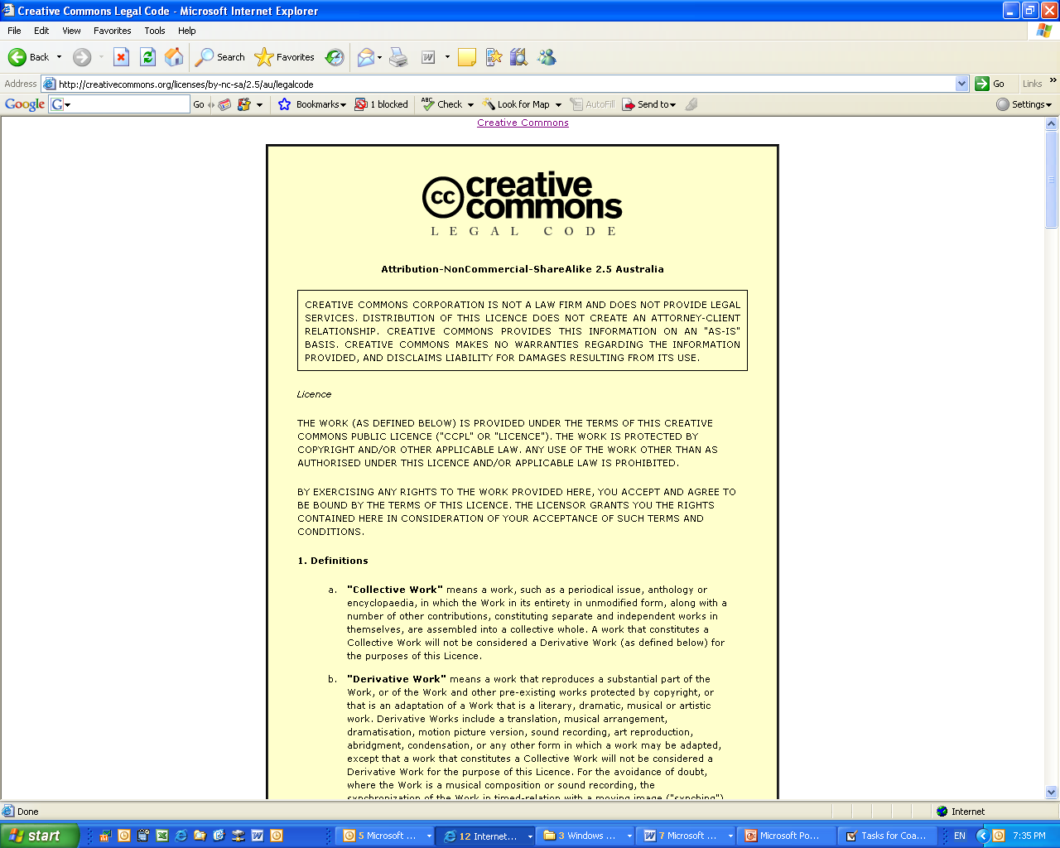
Licences
AUSTRALIA
part of the Creative Commons international initiative
Notes:
The full licence code – which sets out the licence in full legal terms

Slide 9
Benefits for e-dictionaries
CC can be of use to schools and libraries:
  as a resource; and
  as a content management tool.
AUSTRALIA
part of the Creative Commons international initiative
Notes:
These licences could be used by copyright owners to give permission in advance for certain uses of their creative material, that would normally be restricted under the standard copyright rules, without having to give up their copyright entirely
The CC founders hoped that making this easier for copyright owners to do would lead to the creation of a digital commons, a pool of creative material was free to be used, distributed and remixed by others, but only under certain conditions

Slide 10
CC as Resource
CC provides:
a pool of material;
legally available for use (eg as articles, illustrations, adjunct material);
without additional permission and (generally) without payment;
under certain conditions.
AUSTRALIA
part of the Creative Commons international initiative
Notes:
These licences could be used by copyright owners to give permission in advance for certain uses of their creative material, that would normally be restricted under the standard copyright rules, without having to give up their copyright entirely
The CC founders hoped that making this easier for copyright owners to do would lead to the creation of a digital commons, a pool of creative material was free to be used, distributed and remixed by others, but only under certain conditions

Slide 11
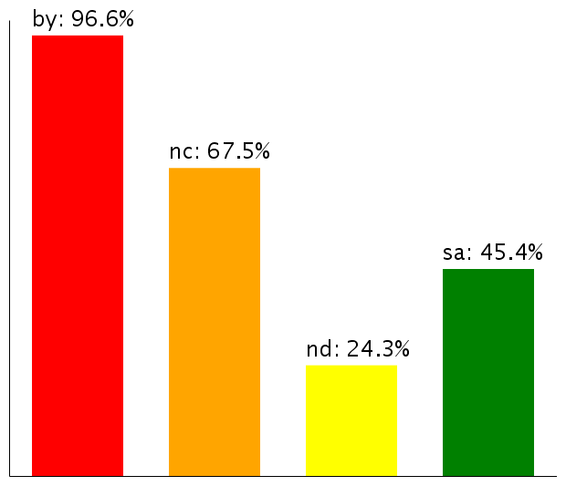
Licence Use – June 2006
Total = 140 million webpages
Most use Noncommercial
General trend towards more liberal licences
Use of licence elements – June 2006
AUSTRALIA
part of the Creative Commons international initiative
Notes:
So – looking at how the CC licences are being used
According to the latest statistics from the CC website, there are currently about 140million webpages that use a CC licence
As you can see, almost all of them contain the BY element – that’s because it was made compulsory for all the licences except the public domain licences after the first year, because pretty much everybody was using it anyway
The majority also, unsurprisingly, choose the non-commercial element
Interestingly, next most popular is ShareAlike, not noderivatives – this shows that there is still a strong focus on fostering creativity among CC community, and that, rather than trying to lock their material up, people are happy for it to be remixed, as long as the new work is also sharedEven more interesting is how these statistics are changing over time
Even more interestingly – if you look at how the licences is being used over time, people are gradually moving towards more liberal licences with less restrictions on them
This movement seems to indicate that as people become more familiar with the licences, they are more comfortable allowing greater use
This is supported by anecdotal evidence from CC users who, after initially publishing their material under restrictive licences that don’t allow derivatives, often ‘re-release’ their material to allow new works

Slide 12
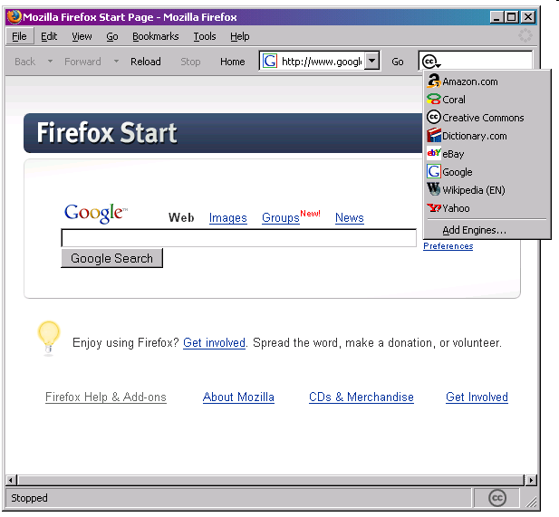
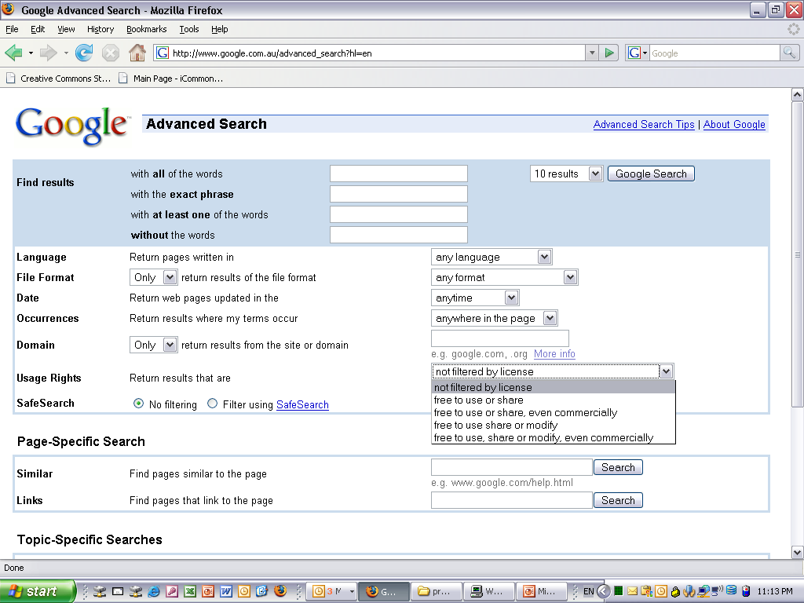
Finding CC Material
Built in metadata makes CC materials easy to find.
Search engines with dedicated CC functions include Google, Yahoo, Flickr and Firefox (Linux web browser).
Creative Commons homepage lets you search by type of material.
AUSTRALIA
part of the Creative Commons international initiative
Notes:
In writing the licences, the main goal was to ensure that the licences are:
Voluntary – contrary to some claims, CC isn’t anti-copyright. It just aims to provide options for those copyright owners who do want to make their material more freely available
Flexible – unlike other parts of the open access movement, CC licences are specifically designed to provide a range of options for licensors, so that they can choose exactly how they want their material to be used
Easy to understand – the academics designing the licences felt that one of the biggest problems with default copyright law is that its so hard for both copyright owners and users to understand. So the licences are specifically designed to be as simple as possible.
And, of course, freely available for everyone to use

Slide 13
Using CC Material
Before using CC material check that your use falls within the licence terms
Most uses by government, educational and non-profit organisations will be non-commercial (unless for profit)
Don’t forget to attribute
AUSTRALIA
part of the Creative Commons international initiative
Notes:
In writing the licences, the main goal was to ensure that the licences are:
Voluntary – contrary to some claims, CC isn’t anti-copyright. It just aims to provide options for those copyright owners who do want to make their material more freely available
Flexible – unlike other parts of the open access movement, CC licences are specifically designed to provide a range of options for licensors, so that they can choose exactly how they want their material to be used
Easy to understand – the academics designing the licences felt that one of the biggest problems with default copyright law is that its so hard for both copyright owners and users to understand. So the licences are specifically designed to be as simple as possible.
And, of course, freely available for everyone to use

Slide 14
CC as Tool
Benefits of using CC licences:
Already drafted, ready to use and free – no lawyers needed
Established system that is easy to use and understand, for managers and users
Recognised by the public and courts internationally
Interoperable with other open content licences (where possible)
AUSTRALIA
part of the Creative Commons international initiative
Notes:
In writing the licences, the main goal was to ensure that the licences are:
Voluntary – contrary to some claims, CC isn’t anti-copyright. It just aims to provide options for those copyright owners who do want to make their material more freely available
Flexible – unlike other parts of the open access movement, CC licences are specifically designed to provide a range of options for licensors, so that they can choose exactly how they want their material to be used
Easy to understand – the academics designing the licences felt that one of the biggest problems with default copyright law is that its so hard for both copyright owners and users to understand. So the licences are specifically designed to be as simple as possible.
And, of course, freely available for everyone to use

Slide 15
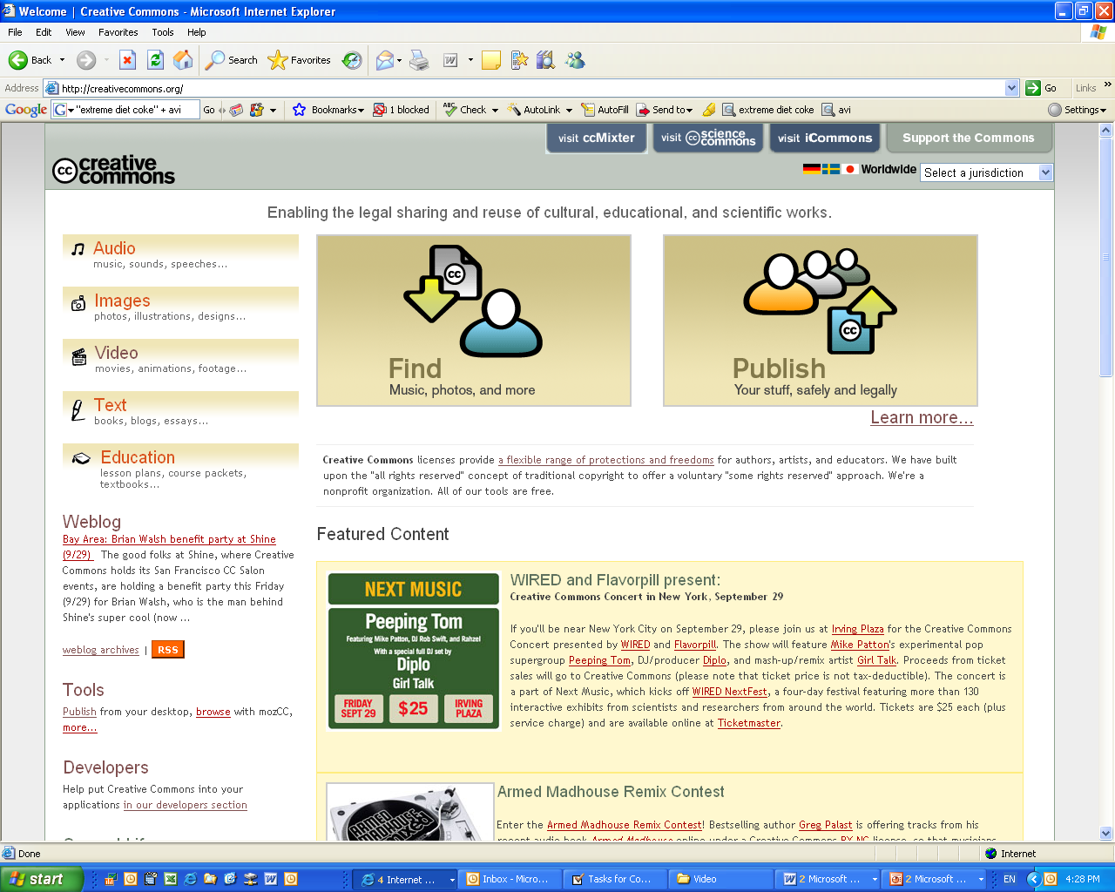
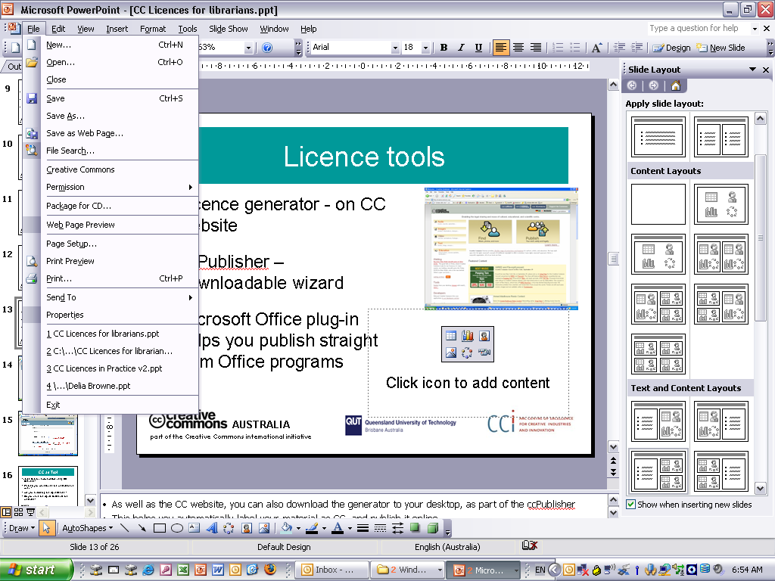
Licence tools
Licence generator - on CC website
ccPublisher – downloadable wizard
Microsoft Office plug-in helps you publish straight from Office programs
AUSTRALIA
part of the Creative Commons international initiative
Notes:
As well as the CC website, you can also download the generator to your desktop, as part of the ccPublisher
This helps you automatically label your material as CC, and publish it online
In an interesting development, Microsoft has also recently released an plugin that allows you to label any work created in an Office as CC.
A number of sites also let you licence your material as cc – including flickr, and blip.tv
Also, if the XHTML text is correctly embedded in the work, the work can be searched for through a series of specific CC search engines
Google, Yahoo, flickr and blip.tv all provide specific CC search tools, as does the firefox web browser

Slide 16
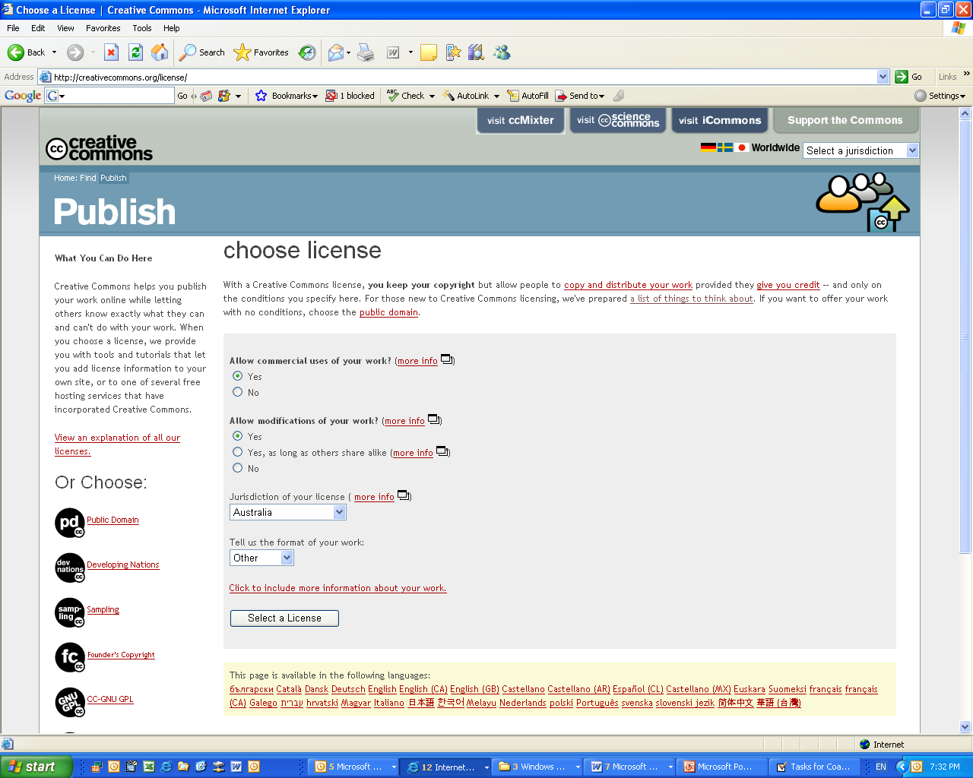
Licences
AUSTRALIA
part of the Creative Commons international initiative
Notes:
To help choose the most appropriate licence, the CC website provides a “licence generator”, which asks simple questions to determine what people are happy to use
By clicking on this button here

Slide 17
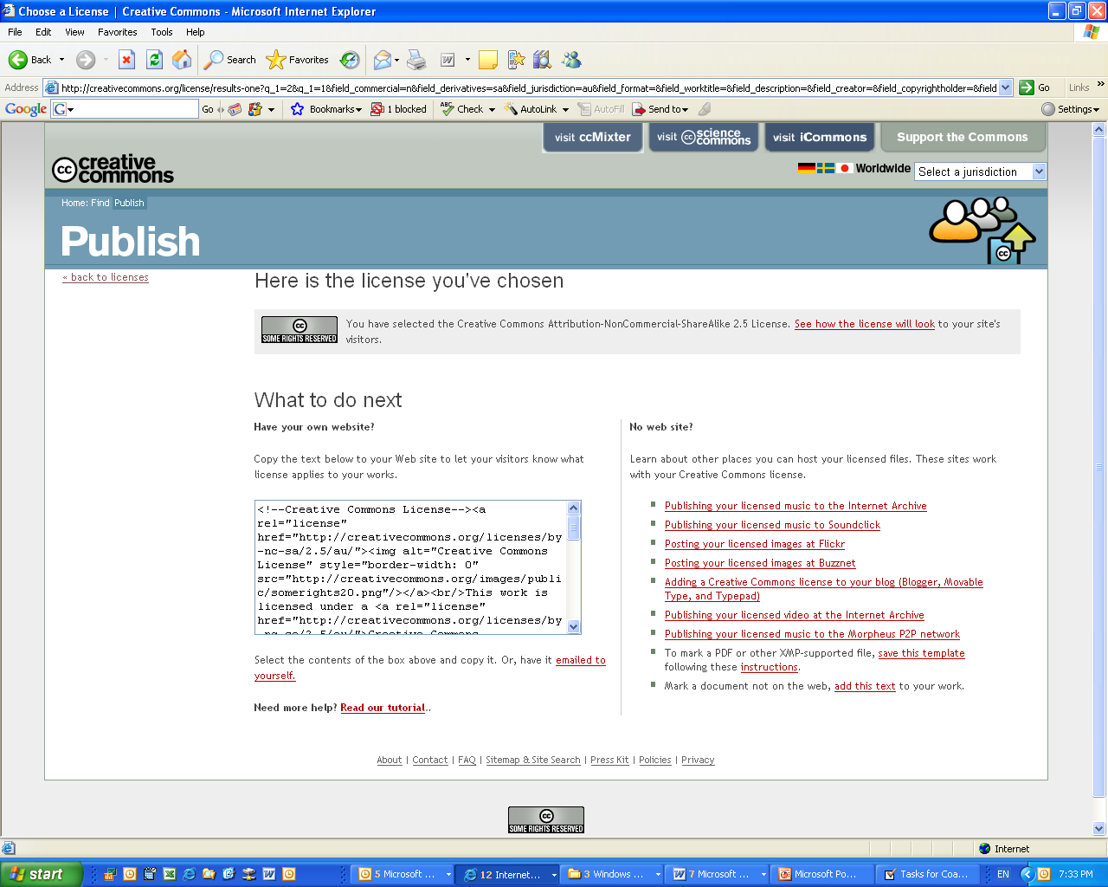
Licences
AUSTRALIA
part of the Creative Commons international initiative
Notes:
Selecting a licence takes you through to a page that provides you with some XHTML text that you can copy onto you website
This basically ‘embeds’ the cc licence into your work, and displays the ‘licence button’ on your site
By clicking on the button, you’re taken through. . .

Slide 18
CC as Tool
Can use CC licences for:
acquisition licensing – from contributors (eg Wikipedia)
access licensing – to users (eg Flickr)
both
AUSTRALIA
part of the Creative Commons international initiative
Notes:
In writing the licences, the main goal was to ensure that the licences are:
Voluntary – contrary to some claims, CC isn’t anti-copyright. It just aims to provide options for those copyright owners who do want to make their material more freely available
Flexible – unlike other parts of the open access movement, CC licences are specifically designed to provide a range of options for licensors, so that they can choose exactly how they want their material to be used
Easy to understand – the academics designing the licences felt that one of the biggest problems with default copyright law is that its so hard for both copyright owners and users to understand. So the licences are specifically designed to be as simple as possible.
And, of course, freely available for everyone to use

Slide 19
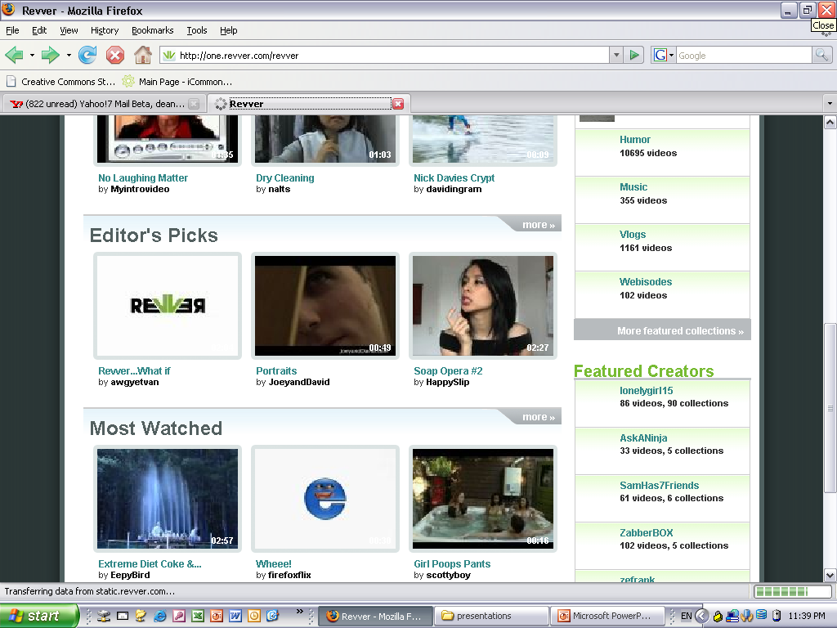
CC as Tool
CC licensing for acquisition or access can be:
Compulsory – for simplicity and utility (eg Revver)
Voluntary – for flexibility (eg PictureAustralia)
AUSTRALIA
part of the Creative Commons international initiative
Notes:
In writing the licences, the main goal was to ensure that the licences are:
Voluntary – contrary to some claims, CC isn’t anti-copyright. It just aims to provide options for those copyright owners who do want to make their material more freely available
Flexible – unlike other parts of the open access movement, CC licences are specifically designed to provide a range of options for licensors, so that they can choose exactly how they want their material to be used
Easy to understand – the academics designing the licences felt that one of the biggest problems with default copyright law is that its so hard for both copyright owners and users to understand. So the licences are specifically designed to be as simple as possible.
And, of course, freely available for everyone to use

Slide 20
Contributor licensing
Benefits of using CC for acquisition licences:
Broadly drafted and perpetual - no orphaned works
Technologically neutral – future adaptable
Can be used to give contributors choice on how material is used (within limits)
AUSTRALIA
part of the Creative Commons international initiative
Notes:
In writing the licences, the main goal was to ensure that the licences are:
Voluntary – contrary to some claims, CC isn’t anti-copyright. It just aims to provide options for those copyright owners who do want to make their material more freely available
Flexible – unlike other parts of the open access movement, CC licences are specifically designed to provide a range of options for licensors, so that they can choose exactly how they want their material to be used
Easy to understand – the academics designing the licences felt that one of the biggest problems with default copyright law is that its so hard for both copyright owners and users to understand. So the licences are specifically designed to be as simple as possible.
And, of course, freely available for everyone to use

Slide 21
User licensing
Benefits of using CC for access licences:
Built in metadata means material is easy to find
Giving permission in advance reduces admin
Increases utility of material for users - can allow material to be shared or used to create new works (eg by teachers, researchers, translated)
Always require attribution
AUSTRALIA
part of the Creative Commons international initiative
Notes:
In writing the licences, the main goal was to ensure that the licences are:
Voluntary – contrary to some claims, CC isn’t anti-copyright. It just aims to provide options for those copyright owners who do want to make their material more freely available
Flexible – unlike other parts of the open access movement, CC licences are specifically designed to provide a range of options for licensors, so that they can choose exactly how they want their material to be used
Easy to understand – the academics designing the licences felt that one of the biggest problems with default copyright law is that its so hard for both copyright owners and users to understand. So the licences are specifically designed to be as simple as possible.
And, of course, freely available for everyone to use

Slide 22
CC as Tool
Things to think about before using CC licences:
Who do you want to use the material, and when? eg global, perpetual
Are you choosing the right licence?
Do you have the rights to license the material?
AUSTRALIA
part of the Creative Commons international initiative
Notes:
In writing the licences, the main goal was to ensure that the licences are:
Voluntary – contrary to some claims, CC isn’t anti-copyright. It just aims to provide options for those copyright owners who do want to make their material more freely available
Flexible – unlike other parts of the open access movement, CC licences are specifically designed to provide a range of options for licensors, so that they can choose exactly how they want their material to be used
Easy to understand – the academics designing the licences felt that one of the biggest problems with default copyright law is that its so hard for both copyright owners and users to understand. So the licences are specifically designed to be as simple as possible.
And, of course, freely available for everyone to use

Slide 23
Case Studies
AUSTRALIA
part of the Creative Commons international initiative

Slide 24
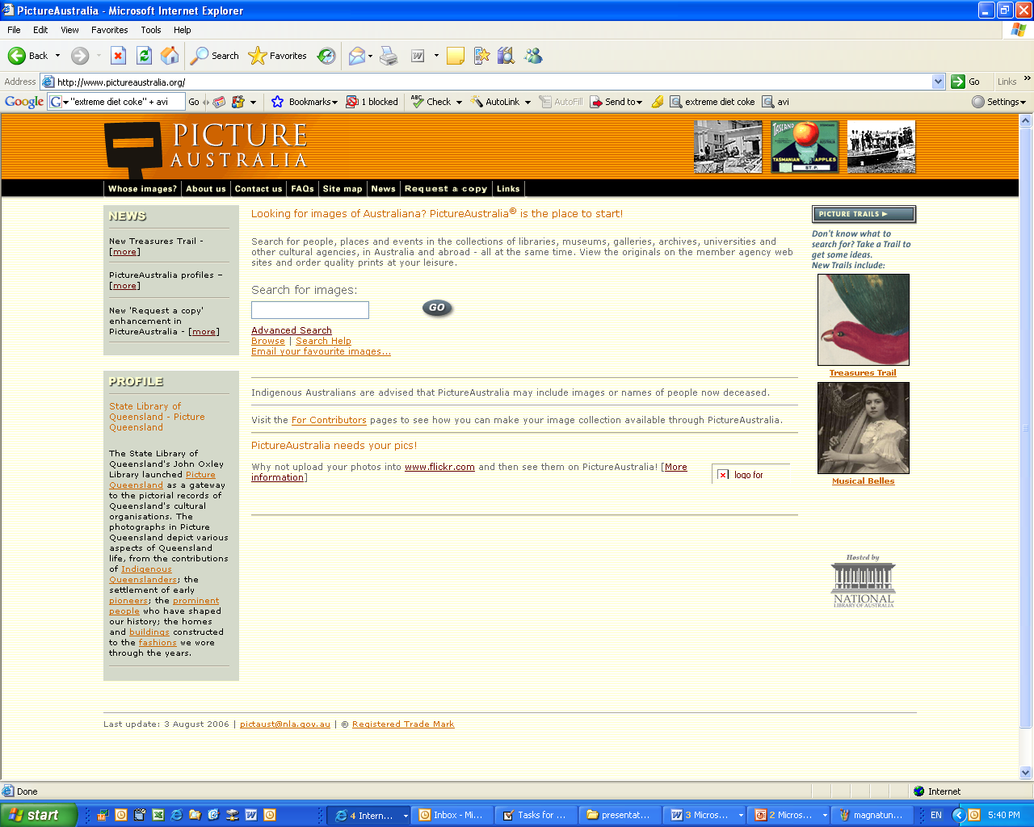
Click and Flick
National Library of Australia, working in collaboration with Flickr
Allows individuals to contribute to National Library PictureAustralia collection through Flickr
Encourages use of Creative Commons licences
AUSTRALIA
part of the Creative Commons international initiative
Notes:
A good example of this is the click and flick project
Launched in January this year, Click and Flick is a project of the NLA’s online pictorial gateway, PictureAustralia, in partnership with flickr
I’m sure most of you are familiar with PictureAustralia, but for those who aren’t, it’s an internet portal that allows users to search over 1.1 million images from 45 organisations across Australia and New Zealand simultaneously.
The click and flick initiative was launched in response to complaints that Picture Australia didn’t contain enough contemporary images
It lets individuals contribute their own images to PictureAustralia by uploading them onto dedicated flickr groups.
Most importantly, the National Library encourages people to licence their material as part of the collection under CC licences

Slide 25
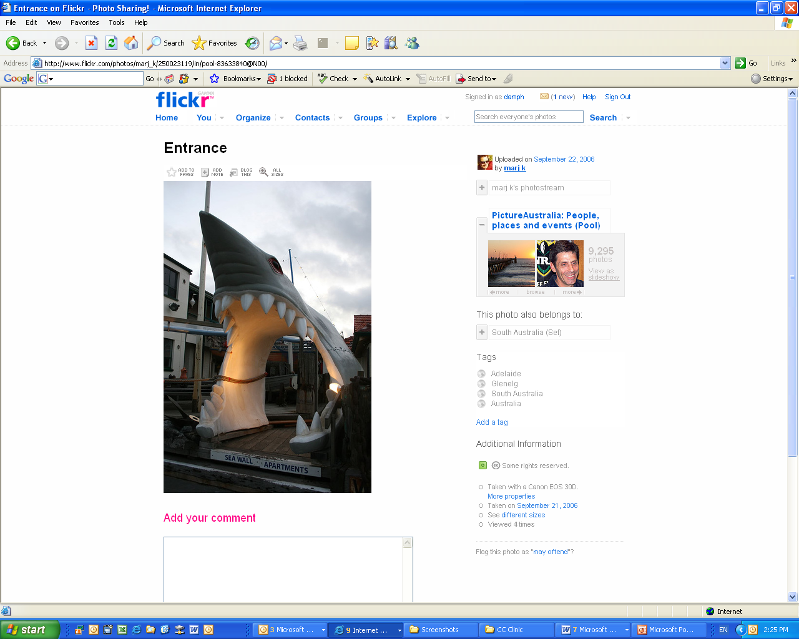
AUSTRALIA
part of the Creative Commons international initiative
Notes:
Under click and flick, individuals upload their photos to dedicated flickr groups
There are currently two dedicated groups – “Australia Day” and “People, places and events”
Once they’ve uploaded their photo they attach the normal flickr tags and metadata, including choosing their licensing option
As you can see, this person has chosen a CC licence

Slide 26
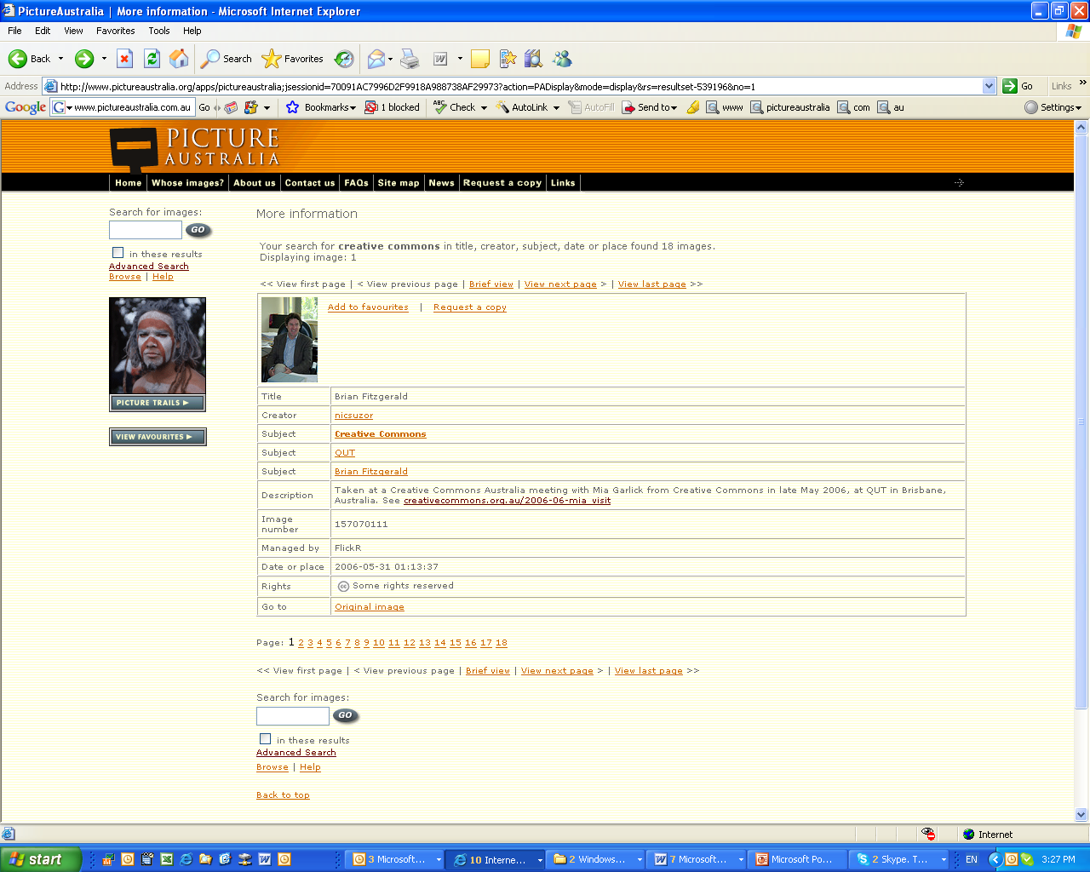
AUSTRALIA
part of the Creative Commons international initiative
Notes:
NLA then automatically downloads both the photos and the metadata onto the PictureAustralia archive, and it becomes a permanent part of the national collection
this is a photo of CC Australia’s fearless leader, Brian Fitzgerald
As you can see, when you bring up the photo details, the rights section indicates that it’s available under a CC licence.
If you click on the reference it will take you to the CC website, which provides you with the details of how the photo can be used

Slide 27

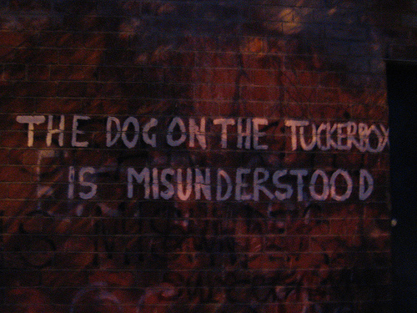
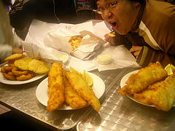
Click and Flick
Over 12,000 photos since January
has raised PictureAustralia profile significantly
About 22% using CC licences – NLA are working to increase this
Antzpantz - http://www.flickr.com/photos/antzpantz/177067581/in/pool-69431001@N00/
:/ - http://www.flickr.com/photos/angelltsang/30211494/
Broken Simulacra -http://www.flickr.com/photos/broken_simulacra/91355505/
AUSTRALIA
part of the Creative Commons international initiative
Notes:
Click and flick has turned out to be highly successful, with over 9,000 photos uploaded since January
This may not seem like much on internet scale, but it’s a huge number for a library collection
It’s also significantly raised the profile of the PictureAustralia collection, with the NLA reporting much higher usage, even during traditionally slow periods
The NLA doesn’t have any statistics on how many people are using CC licences, but they say anecdotally that they think it is a large portion, or even the majority.

Slide 28
Click and Flick
Benefits from using CC:
Ideological - encourages contributors to “think like librarians” re public benefit of access
As resource for users - creates pool of photos that can be used without additional permission
Content management tool - NLA can harvest, maintain and promote the collection without additional permissions
AUSTRALIA
part of the Creative Commons international initiative
Notes:
So why is the NLA using the CC licences?
There is, of course, the obvious ideological reasoning – PictureAustralia is, after all, part of the national collection, and the more freely available the photographs are, the better.
It also provides benefits to the users of PictureAustralia, by creating a pool of photos on the website that can be re-used without needing to get additional permission.
Currently, users have to get permission from the host organisation if they want to reproduce most of the photos in the archive
But most significantly, the NLA also chose to use CC licences because of the benefits content management benefits that provides to them
If anyone has worked in a library, they know that one of the biggest problems with maintaining a collection is making sure that the library has all the permissions it needs to preserve and manipulate the individual works – particularly where the copyright owner may be difficult or impossible to locate
By getting the work under a CC licence, the NLA is able to give people a choice over how their material may be used, whilst still being sure that it has the rights it needs to deal with the work from the outset
This includes making it available on the library’s website, or in a catalogue

Slide 29
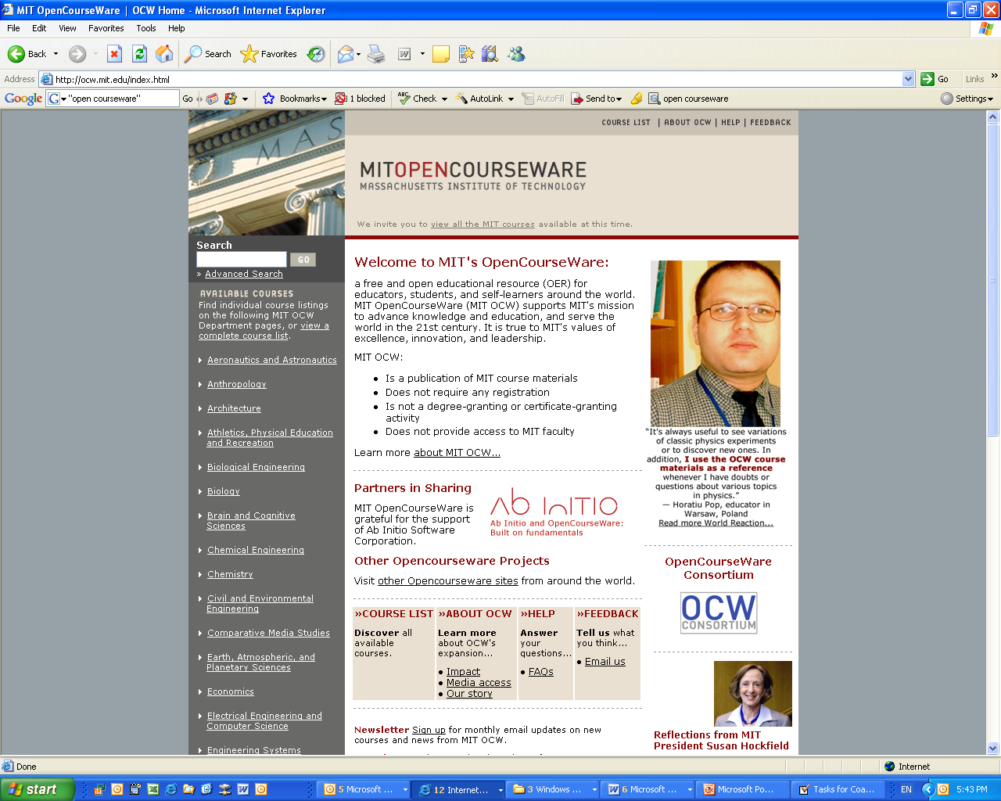
MIT Open Courseware
Publishes course materials from MIT undergraduate and graduate courses under an CC Attribution-Noncommercial-Sharealike
Free, searchable, access for anyone (eg educators, students, and self-learners) around the world
All can be used or changed, as long as you sharealike
AUSTRALIA
part of the Creative Commons international initiative
Notes:
BBC
releasing all of back-catalogue work under a licence based on the CC licence
Looked at using CC, but decided had to limit it geographically to comply with existing distribution licences
Created own licence with same licence elements as CC, but with an extra badge
MIT Opencourseware
large-scale, Web-based electronic publishing initiative by MIT
aims to provide free, searchable, access to MIT's course materials for educators, students, and self-learners around the world.
Publishes the course materials from virtually all of MIT's undergraduate and graduate courses under an Attribution-Noncommercial-Sharealike
what it particularly interesting is that it’s free to be used or changed by other educators, as long as they sharealike
Sciencecommons
Part of initiative of open access journals, which aim to make research more widely available by:
Publishing in open access journal
Getting journal agreement to ‘self-archive’ on the researcher’s own site
Publishing drafts etc on own site/in open access journal
More and more publicly-funded grants are making it a requirement of the grant that findings be published openly

Slide 30
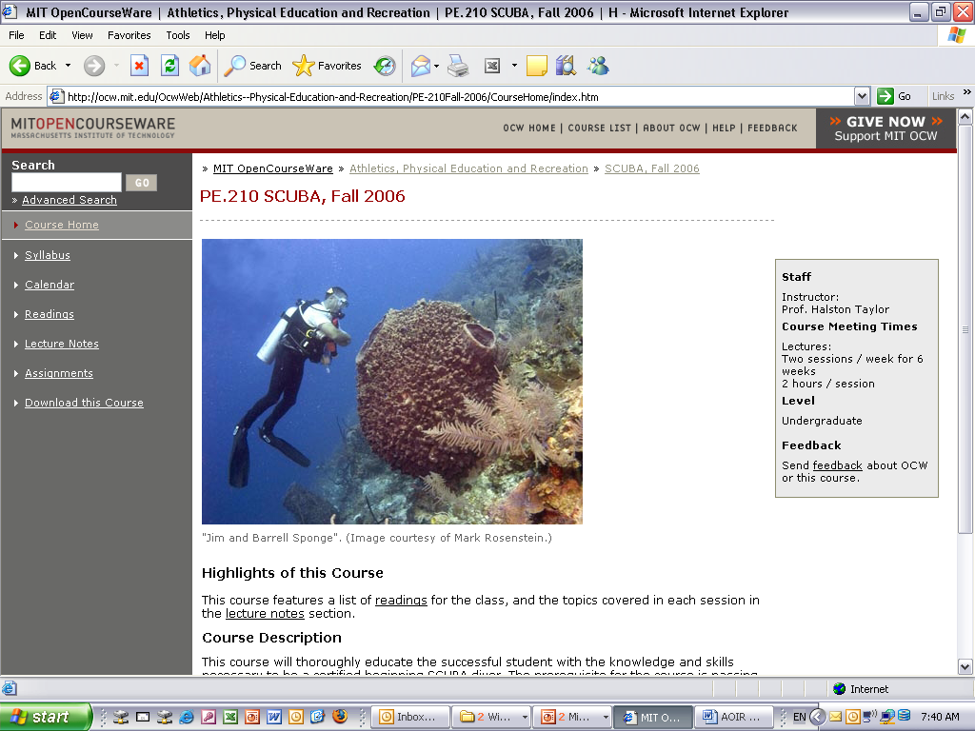
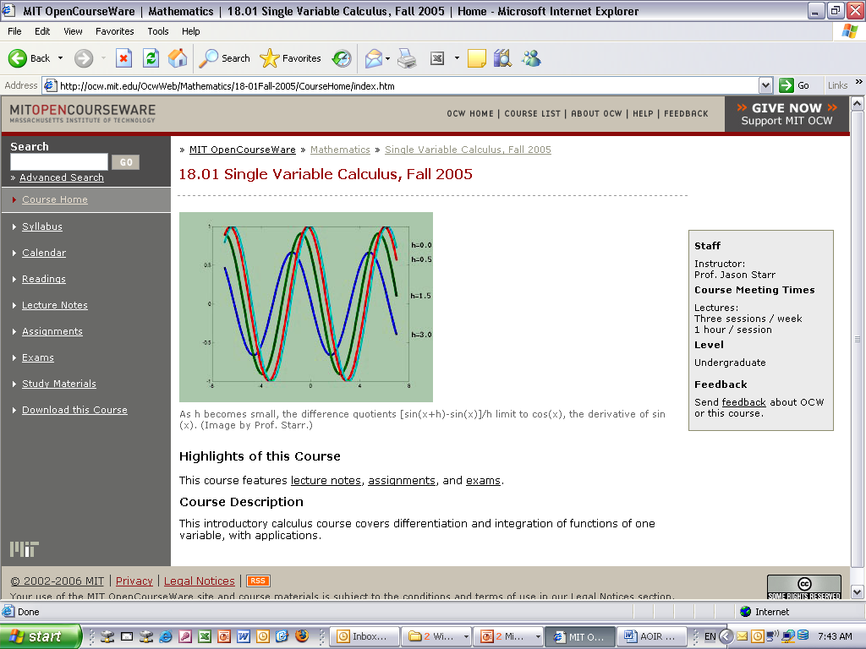
MIT Open Courseware
Over 1,400 courses from 34 departments
Includes syllabi, lecture notes, course calendars, problem sets and solutions, exams, reading lists, video lectures.
Advanced search facilities – limit by type, time period, subject etc
Translated under formal agreements and CC licences
AUSTRALIA
part of the Creative Commons international initiative
Notes:
BBC
releasing all of back-catalogue work under a licence based on the CC licence
Looked at using CC, but decided had to limit it geographically to comply with existing distribution licences
Created own licence with same licence elements as CC, but with an extra badge
MIT Opencourseware
large-scale, Web-based electronic publishing initiative by MIT
aims to provide free, searchable, access to MIT's course materials for educators, students, and self-learners around the world.
Publishes the course materials from virtually all of MIT's undergraduate and graduate courses under an Attribution-Noncommercial-Sharealike
what it particularly interesting is that it’s free to be used or changed by other educators, as long as they sharealike
Sciencecommons
Part of initiative of open access journals, which aim to make research more widely available by:
Publishing in open access journal
Getting journal agreement to ‘self-archive’ on the researcher’s own site
Publishing drafts etc on own site/in open access journal
More and more publicly-funded grants are making it a requirement of the grant that findings be published openly

Slide 31
MIT Open Courseware
Impact on users:
95% of users report OCW has or will help them to be more productive and effective
46% of educators have adopted OCW content to improve their own teaching
38% of students use OCW materials to complement courses they are taking, 34% to learn about subjects outside formal classes
56% of self-learners use MIT OCW to enhance personal knowledge, 16% to stay current in their chosen field
AUSTRALIA
part of the Creative Commons international initiative
Notes:
BBC
releasing all of back-catalogue work under a licence based on the CC licence
Looked at using CC, but decided had to limit it geographically to comply with existing distribution licences
Created own licence with same licence elements as CC, but with an extra badge
MIT Opencourseware
large-scale, Web-based electronic publishing initiative by MIT
aims to provide free, searchable, access to MIT's course materials for educators, students, and self-learners around the world.
Publishes the course materials from virtually all of MIT's undergraduate and graduate courses under an Attribution-Noncommercial-Sharealike
what it particularly interesting is that it’s free to be used or changed by other educators, as long as they sharealike
Sciencecommons
Part of initiative of open access journals, which aim to make research more widely available by:
Publishing in open access journal
Getting journal agreement to ‘self-archive’ on the researcher’s own site
Publishing drafts etc on own site/in open access journal
More and more publicly-funded grants are making it a requirement of the grant that findings be published openly

Slide 32
MIT Open Courseware
Impact on teaching and learning at MIT:
71% of MIT students use OCW; of these 96% say it has had a positive impact on their student experience
38% of MIT faculty use the site for advising students; of these 40% report that the site is a helpful tool in revising/updating courses
35% of freshmen aware of OCW indicate it was a significant influence on their choice of school
More than 50 other institutions now openly publish their materials in open environments
AUSTRALIA
part of the Creative Commons international initiative
Notes:
BBC
releasing all of back-catalogue work under a licence based on the CC licence
Looked at using CC, but decided had to limit it geographically to comply with existing distribution licences
Created own licence with same licence elements as CC, but with an extra badge
MIT Opencourseware
large-scale, Web-based electronic publishing initiative by MIT
aims to provide free, searchable, access to MIT's course materials for educators, students, and self-learners around the world.
Publishes the course materials from virtually all of MIT's undergraduate and graduate courses under an Attribution-Noncommercial-Sharealike
what it particularly interesting is that it’s free to be used or changed by other educators, as long as they sharealike
Sciencecommons
Part of initiative of open access journals, which aim to make research more widely available by:
Publishing in open access journal
Getting journal agreement to ‘self-archive’ on the researcher’s own site
Publishing drafts etc on own site/in open access journal
More and more publicly-funded grants are making it a requirement of the grant that findings be published openly

Slide 33
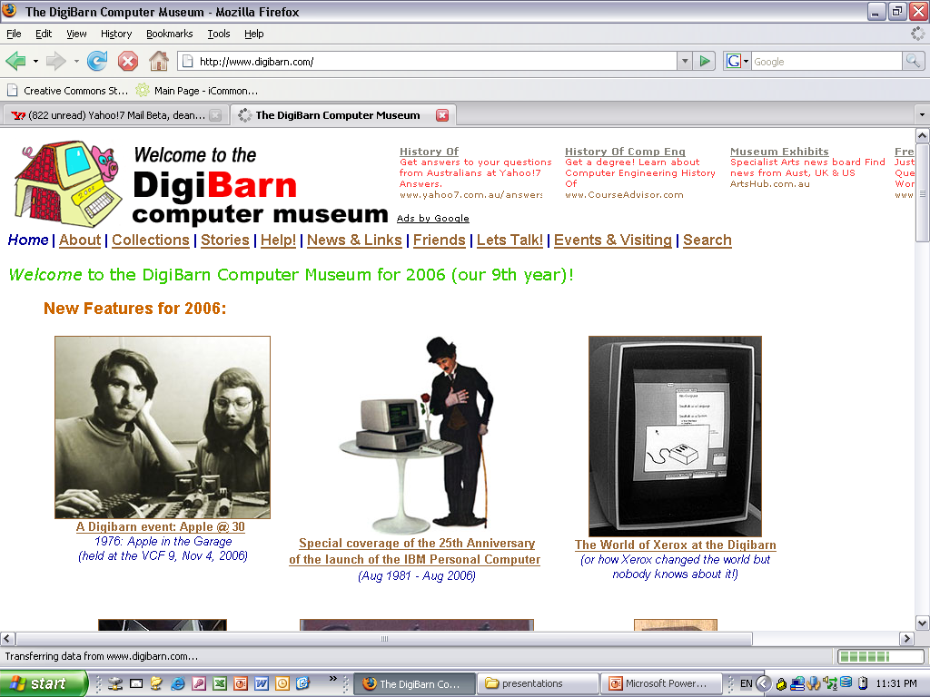
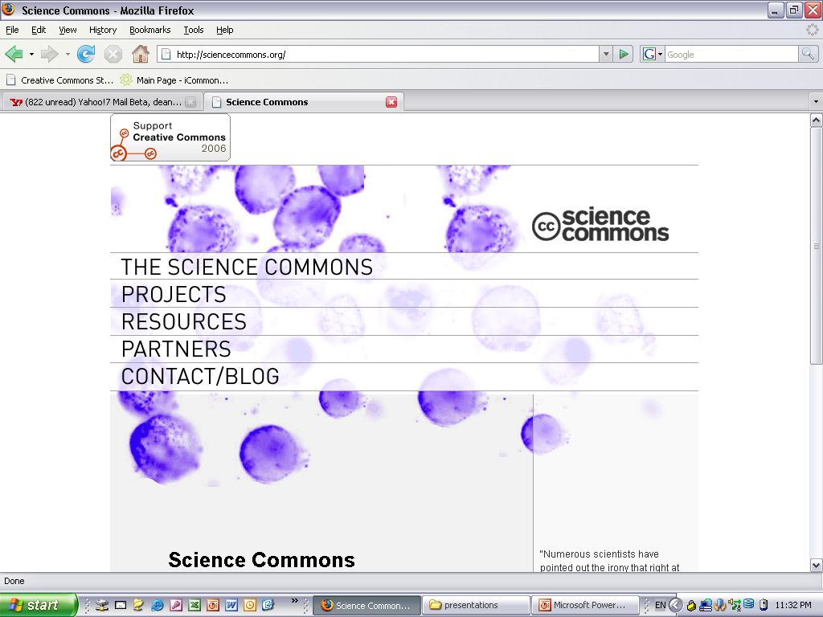
Other sites
Science Commons – Open Access Law Journal Principles
Creative Archive Project – CC-based licence
Digibarn – real-world and online collection of digital heritage
AUSTRALIA
part of the Creative Commons international initiative
Notes:
BBC
releasing all of back-catalogue work under a licence based on the CC licence
Looked at using CC, but decided had to limit it geographically to comply with existing distribution licences
Created own licence with same licence elements as CC, but with an extra badge
MIT Opencourseware
large-scale, Web-based electronic publishing initiative by MIT
aims to provide free, searchable, access to MIT's course materials for educators, students, and self-learners around the world.
Publishes the course materials from virtually all of MIT's undergraduate and graduate courses under an Attribution-Noncommercial-Sharealike
what it particularly interesting is that it’s free to be used or changed by other educators, as long as they sharealike
Sciencecommons
Part of initiative of open access journals, which aim to make research more widely available by:
Publishing in open access journal
Getting journal agreement to ‘self-archive’ on the researcher’s own site
Publishing drafts etc on own site/in open access journal
More and more publicly-funded grants are making it a requirement of the grant that findings be published openly

Slide 34
Thanks
http://www.creativecommons.org
http://www.creativecommons.org.au
info@creativecommons.org.au
AUSTRALIA
part of the Creative Commons international initiative
Notes:
If you want to find out more about the CC licences and how they are being used I can recommend the CC international website at ……….
For more information on CC in Australia, our website is……….

